Slide 1




EIB Venture Debt and Thematic Finance

Slide 2

What is venture debt?
Venture Debt
Financing the growth stage of innovative companies
Bank debt
M&A
Public market
etc.
Exit / Further Series
Series A/B/C
Grants
Friends & Family
Own funds
Seed
Set-up
Proof of concept
Pre-commercialization
Early commercialisation
Growth
Mature
EIB Venture Debt website - https://www.eib.org/en/products/equity/venture-debt.htm

Slide 3




Venture Debt: We are looking for the next European tech champions
Innovation-driven companies with growth driven by the value of own intellectual property, with the potential to become a future EU tech champion
✓
Companies that have already raised Series A/B/C equity and need additional financing to accelerate growth
✓
Strong and sustainable business model, professional management team and established corporate governance
✓
Investments to be financed are located in the EU
✓

Slide 4
Venture Debt: We are looking for the next European tech champions
Structure Elements
Staged disbursements based on milestones (de-risking subsequent disbursements)
Typically bullet repayment for the disbursed tranches at maturity/exit
Long availability (30-36 months) to allow implementation of comprehensive, long term R&D investment plans
Cash flows / cash balance
Disbursement
Repayment
Commitment
Disbursement
Repayment
Year 1
Year 2
Year 3
Year 4
Year 5
Year 6
Year 7
Year 8

Slide 5
Venture Debt summary term sheet
Eligible investee European SMEs and Midcaps
Eligible project Investment project related to the growth of the company and may include expenses such as: R&D, capex, opex related to growth, permanent increase in working capital, market expansion etc.
Co-investment EIB finances maximum 50% of eligible project costs, co-investment with third-party sources or own resources
Ticket EUR 5m – EUR 50m
Tenor and repayment Repayment typically as bullet 4 to 6 years after drawdown, convertible or bridge to exit
Availability Tranches are available for disbursement up to 36 months after signature (or longer in specific cases)
Pricing May include one or more of the following, in relation to risk undertaken:
- typically equity-linked instrument (warrants) or profit participation or convertible and / or
- cash / capitalized interest
Security Un/Secured
Fees Certain fees applicable
Appraisal Usually between 4 and 7 months

Slide 6



Companies
Increase runway to next milestone, funding round, exit or break-even
Provide cushion and visibility
Signaling effect
Founders
Limited dilution & loss of control
Extend time between next funding round
Hands-off approach with no direct involvement
Investors
Complementarity
IRR enhancement
Maintenance of control
Long-term loans match timing of investment

Slide 7

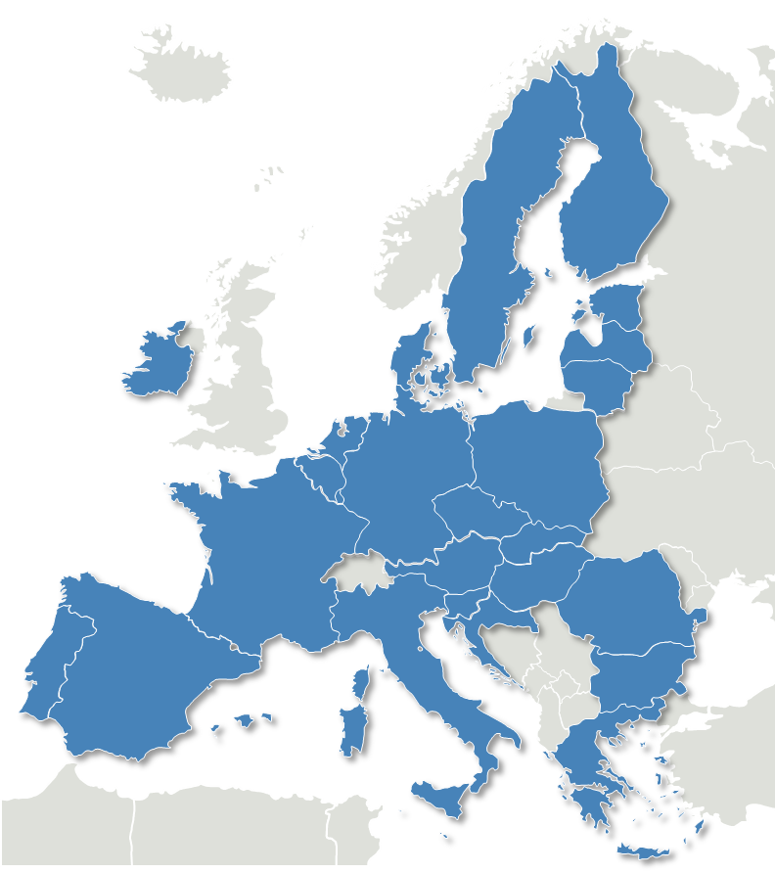


















































































Financed
Signed
Jobs supported
(mainly highly skilled R&D)
👥
more than 26,000
190+ companies to date
€4bn financing to date

Slide 8
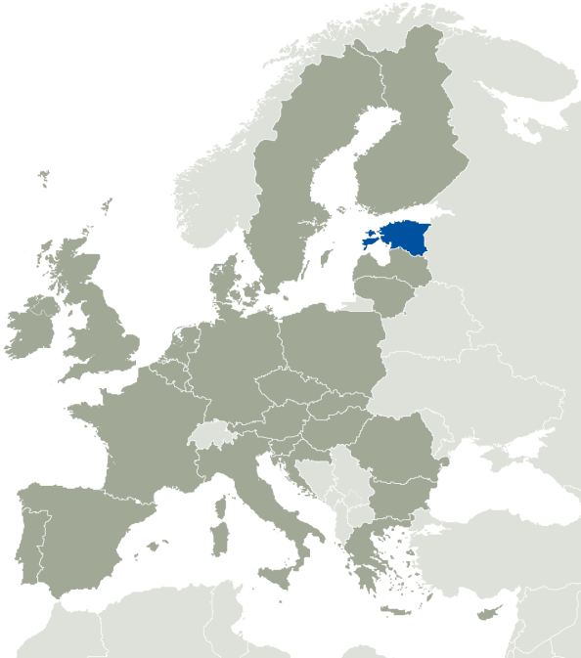


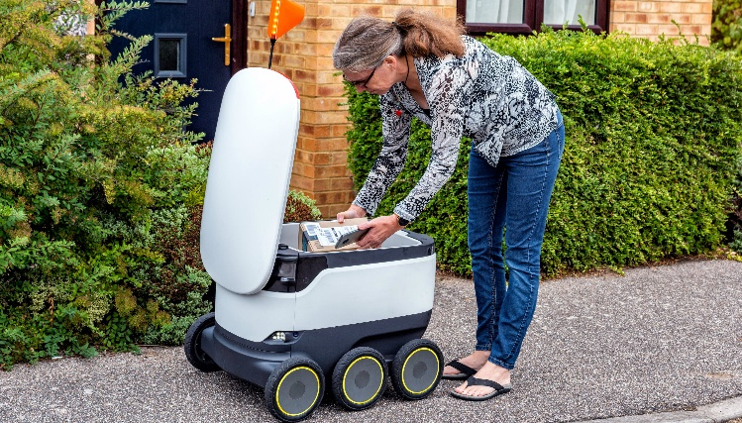
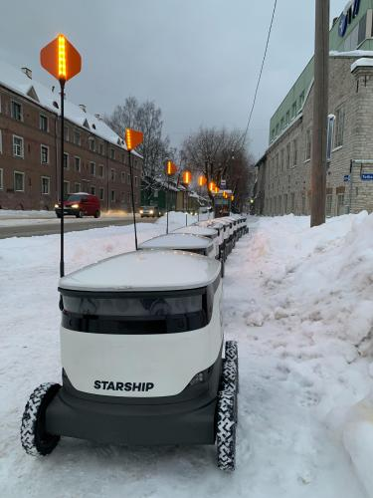
Venture Debt example transactions
Starship
Delivery robots
Amount: EUR 50m
Sector: Engineering
Country: Estonia
Signed: Dec 2021
Starship Technologies is a robotics startup with the R&D based in Estonia and Finland
Starship developed robots that drive on sidewalks to deliver products to households.
The company’s robots are the most advanced autonomous driving technology for last mile delivery and as of March 2022 Starship had the most autonomous deliveries realized (3 million).
Starship’s technology has a substantial artificial intelligence component, making the robots capable to navigate autonomously. The robots can climb kerbs and safely cross roads at traffic lights, standard crossings and if needed in non-marked areas. They identify vehicles exiting garages, pedestrians, wheelchairs and other vehicles on the sidewalk and safely avoid them where necessary.
Investment rationale:
Estonian technological leader with significant potential, operating in a fast-growing market underpinned by strong fundamentals.

Slide 9

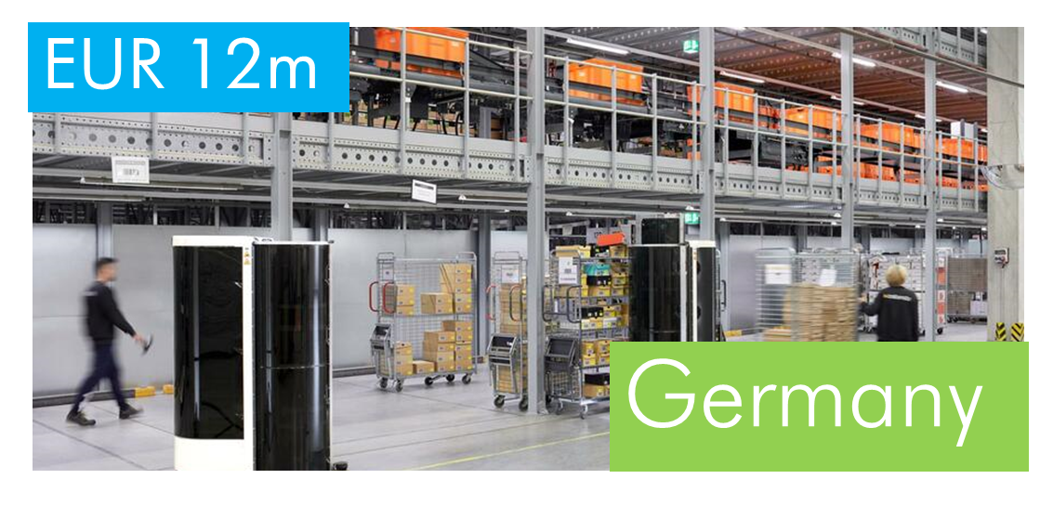
Venture Debt example transactions
Prophesee
An eye for machines using AI
European start-up developing a disruptive AI machine vision sensor.
Similar to the human eye and brain, Prophesee’s neuromorphic camera sensors capture meaningful events instead of pixels or frames.
Prophesee’s cameras can detect events much faster, resulting in for example significantly safer autonomous driving.
Countless applications in advanced manufacturing, industrial robotics and automation, IoT and Augmented Reality applications.
Magazino
Robotic automation of logistics
European start-up developing intralogistics robots.
Developed collaborative robots that can efficiently perform tasks such as picking or placing of items in a warehouse or bringing required items on the production lines.
Substantial AI breakthroughs in object recognition and manipulation and in collaboration of fleets of robots.
Magazino’s robots complete low value repetitive tasks that companies have difficulty implementing.

Slide 10


Thematic Finance
Health, Energy/Circular Economy and Transport Sectors
Finances flagship projects that are potential change-makers in their sector
Targets innovative solutions compared to the current state-of-the-art
Supports and accelerates the commercialisation and further rollout to the market of impactful technologies
Thematic finance can accommodate higher risk (lower TRL) and longer tenors
Objective
Designed to meet the specific needs of pre-commercial projects and companies
Areas eligible for Thematic Finance:
  Health Innovation (highly innovative vaccines, therapeutics, diagnostics)
  Sustainable Investments
    Clean energy / low carbon innovation
    Future Mobility
    Circular Economy
    Bio/Blue Economy
    Energy Intensive Industry Low-carbon solutions
  Future Technologies
    e.g. highly innovative tech in space, sustainable ICT,
    quantum computing, AI, blockchain, targeting Green Deal, advanced materials
Areas

Slide 11




Thematic Finance Focus: Clean Energy and Low Carbon
Support the emergence of new and disruptive technologies in the Energy sector
1
2
3
Emergence of new RE production and technologies
Energy Network Flexibility
Low Carbon solutions for Industry
Support the demonstration of unproven technologies for the production of renewable energy
Wave energy, new generation of PV technology, floating windmill, biomass, biocoal and bio-ethanol
The increased RE in the energy mix brings new infrastructure challenges
New energy storage solutions are required
Smart solution such as demand response, Vehicle/House to Grid solutions help
Emergence and mainstreaming of carbon reducing technologies for heavy industry need to be accelerated.

Slide 12





Thematic Finance Focus: Future Mobility
Safer, Cleaner and Smarter mobility solutions
1
2
1
2
3
New Infrastructure
Production of Alternative fuels
IT based solutions
Migration to non-fossil fuel requires a swift rollout of new infrastructure with signification market risk in their initial phase
Modal shifts also requires adapted infrastructure
The emergence of H2 as a mainstream alternative fuel for heavy vehicles has important technological and market risk
New IT based solution are changing our approach to transport modes with potential to increase efficiencies, shared mobility and to reduce our carbon footprint.

Slide 13

Thank you!
For further questions: vilnius@eib.org

