Slide 1




InvestEU
Delivering on the
InvestEU Fund

Slide 2
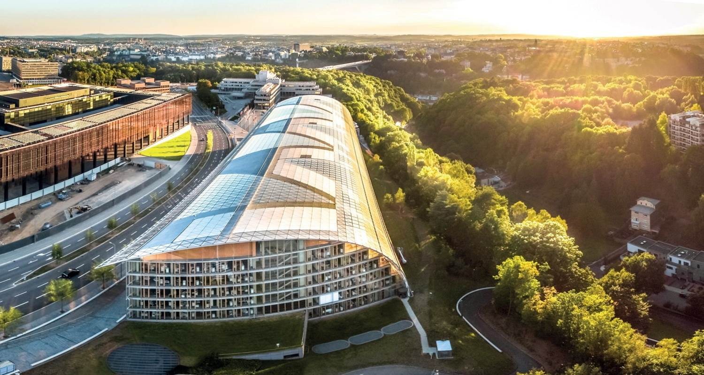

The EIB Group
Providing finance and expertise for sound and sustainable investment projects in line with the EU priorities
Leading developer of risk financing for innovative SMEs
Notes:
EIB facts:
The EIB is the European Union's bank. We are the only bank owned by and representing the interests of the European Union Member States. We work closely with other EU institutions to implement EU policy.
We are the world’s largest multilateral borrower and lender. We provide finance and expertise for sustainable investment projects that contribute to EU policy objectives. More than 90% of our activity is in Europe. But we also are a big investor around the world.
We support projects that make a significant contribution to growth and employment in Europe. Our activities focus on four priority areas:
Innovation and skills
Access to finance for smaller businesses
Infrastructure
Climate and environment
We raise the money we lend on the international capital markets through bond issues. Our excellent rating allows us to borrow at good rates. We’re not in this to make a big profit. So we pass these good rates onto our clients.
EIF facts
Established in 1994, the EIF is a specialist provider of risk finance to benefit small and medium-sized enterprises (SME) across Europe. EIF shareholders are the European Investment Bank (EIB), the European Union, represented by the European Commission, and a wide range of public and private banks and financial institutions.
The EIF carries out activities using either own resources or those provided by the European Investment Bank, the European Commission, by EU Member States or other third parties.
By developing and offering targeted financial products to intermediaries, such as banks, guarantee and leasing companies, micro-credit providers and private equity funds, the EIF enhances SMEs access to finance.

Slide 3

EIB: the EU Bank
Investing in
Europe’s future
Main financing partner for the EU member states since 1958
More than13.000 projects financed in 160 countries (90% in the EU)
Shareholders: all EU member states
Notes:
Our HQ: Founded in Brussels in 1958 as the Treaty of Rome comes into force, we moved to Luxembourg in 1968. We relocated to our current site in 1980 with a major new building extension completed in 2008.
Lending: From ECU 10bn in 1988, our annual lending neared EUR 45bn in the mid-2000s before jumping to EUR 79bn in 2009 as a temporary response to the crisis. It was EUR76.358bn in 2016.
Capital: From less than ECU 30bn in the early 1990s, our capital-base rose to EUR 243bn at 1st July 2013. The capital adequacy ratio was 28.7% at the end of 2013.
Partner countries: We made our first agreements with non-Member States and non-European countries in the early 1960s. Now we work with over 150 non-EU states which receive around 10% of our funding.
Our people: From a workforce of 66 in 1958, we passed 1 000 staff members in 1999, and the total is now over 2 900. Most work in Luxembourg, but we also have external offices, in the European Union and across the regions in which we are active around the world

Slide 4


Why the InvestEU Programme?
EU in 2020
Investment gap in key policy areas
High risk characteristics of operations in key policy areas
Limited public resources and persistent investment barriers
COVID-19 crisis
… and since
Economic Impact of COVID-19 and Russian invasion in Ukraine
Notes:
The InvestEU Regulation was adopted in 2020. The EC considers that, as a policy instrument, the InvestEU Programme's overall objective is to support the policy objectives of the Union by mobilising public and private investment within the EU, hereby addressing market failures and investment gaps that hamper the achievement of EU goals regarding sustainability, competitiveness and inclusive growth.
The purpose is to supply financing to economic actors with a risk profile that private financiers are not always able or willing to address in order to promote competitiveness of the EU economy, sustainable growth, social resilience and inclusiveness and the integration of capital markets in the EU in line with EU policy objectives in different sectors.
For economically viable projects with a revenue generating capacity, a more systemic use of a budgetary guarantee can help increasing the impact of public funds.
In order to respond to the crisis caused by the COVID-19 Pandemic, the European Recovery Instrument was created in 2020. Part of the InvestEU Programme is funded from the Next Generation EU budget, made available through the European Recovery Instrument.
The war in Ukraine has put yet another challenge to the InvestEU Programme, testing its flexibility to be used in response to the needs arising in countries neighbouring the Ukraine, but also in Europe overall.

Slide 5


InvestEU Fund
75%
EUR 26.7bn*
25% - Other Implementing Partners
InvestEU Fund
Sustainable Infrastructure Window
Research, Innovation and Digitalisation Window
Small and Medium Enterprises Window
Social Investment and Skills Window
* It is possible that in the future, Member States contribute to the InvestEU guarantee under the Member State compartment and that Top-Ups come from Sectoral Programmes from different Policy DGs
Notes:
The EU guarantee provided under the InvestEU Fund enables the EIB Group to step up its provision of additional risk-bearing capacity, enabling to improve the impact of its operations.
Through InvestEU, the EIB Group improves its ability to perform its catalytic function, increasing the capacity to mobilise additional investments. It can contribute to canalize the high liquidity in the market, accelerating the decisions for financing projects, where otherwise investors still do not enter due to higher aversion to risk.
This higher value added absorbing part of the risk to trigger additional investments, so that other investors can come at a senior position, shall attract other sources of finance.
The EIB Group encourages the launch of economically viable projects, making them attractive for wary investors, to help accelerate and increase investment in Europe.

Slide 6

InvestEU project selection and eligibility criteria
EIB selection criteria
be commercially sound, economically and
technically viable
Projects need to
support EU priorities
be mature enough to be bankable
be within EU or cross-border operations
Additional InvestEU eligibility criteria
address market failures or sub-optimal investment situation
need to be additional
achieve a multiplier effect and where possible crowd-in private investment
help meet EU policy objectives
Notes:
What it means to be additional:
All deals (except thematics) are bankable and hence – in principle can be done also without guarantee…. BUT…. Thanks to the guarantee we can push the boundaries. We can take larger tickets, go subordinate, give up on collateral, etc… we can accelerate and facilitate projects and hence add value and improve crowding in… we can provide a higher volume of high risk operations compared to what we would do at OR. So we push the boundaries not only for every operation (if there is a need), but also in overall volumes.
Every operation presented by an IP under InvestEU has to demonstrate at least one feature of additionality as defined in the Annex V of the InvestEU Regulation.: for example
- We are able to assume higher risks either by taking a subordinated position or offering more favourable terms compared to co-financiers or by supporting operations that carry a higher risk profile than EIB would usually accept or accept only to a limited extent. This benefits for example corporate clients in their R&D efforts.
Through risk sharing mechanisms with banks, EIB can support financial institutions, including smaller ones, that are on their own not willing or able to accept risk levels in certain policy areas that are supported under InvestEU.
Start-ups, innovative MidCaps and other private sector actors can benefit from EIB’s equity and quasi-equity support through InvestEU. The Thematic Financial Products under InvestEU provide EIB with an additional flexibility to support clients who are usually in a nascent market where there is no easy risk assessment possible as the streams of revenues are far from being certain, or with very innovative technologies at demonstration or early deployment stage.
Through InvestEU, EIB can catalyse and crowd-in private financing and accelerate the projects in the financial closing. This is of particular value for project finance operations but also for corporate deals.
InvestEU enables EIB to offer debt with longer tenors and be more flexible in terms of pricing, collateral or other risk requirements, which particularly can benefit sub-sovereign public sector entities and MidCaps.
Finally, InvestEU enables EIB to offer financial innovation in target countries or regions, where markets are missing, underdeveloped or incomplete. Again, the Thematic Financial Products under InvestEU allow EIB to support clients in an even more flexible way. The offer of venture debt to corporates for capital expenditures and R&D activities in space technologies or for pre-commercial stage investments is key to achieve the innovation needed in key sectors of the European Economy.

Slide 7
EIB offer under InvestEU
EIB
Direct IEU transactions – while bankable in principle – allow the Bank to facilitate or accelerate projects by pushing certain boundaries beyond EIB standards: (i) maturity, (ii) subordination, (iii) less collateral,…
Corporate / MidCap
Venture Debt
Project Finance / PPP
Public Sector
Financial Intermediary
Smaller Final Recipients (e.g. SMEs, municipalities,…)
Indirect Invest EU transactions aim to share risks with banks and other intermediaries in order to allow them to directly engage in eligible IEU transactions.

Slide 8
Different Financing Structures
EIB
Loan
Project promoter
Project
EIB
Loan
Bank
Project 1
Project 2
EIB
Loan
Government/Self Government
Project 1
Project 2
EIB
Loan/
Participation
Fund
Investees
EIB
PF Loan
Project
Project promoter

Slide 9
BENEFITS OF WORKING WITH EIB
1
2
3
EIB offers attractive interest rates to its clients (fixed and floating) due to its cheaper funding costs (Aaa rating)
Long maturity matching
economic life of project assets.
Financing tangible and intangible investments with up to 50% of project cost.
4
5
6
Flexible approach to disbursement –both fixed and floating rates of different maturities can be selected for different tranches.
Signaling Effect and Quality Stamp – crowding in of private investors. Diversification of borrower’s funding sources.
Up to 36 months availability period
.

Slide 10

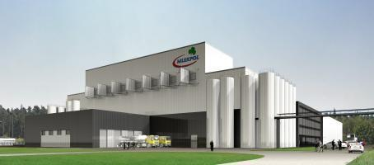
Zoom on some of the deals
EUR 50m investment loan financing to Mlekpol
Project Cost | EUR 108m
Loan amount | EUR 50m
Long-term financing to enable Mlekpol to accelerate its growth.
The project will enable Mlekpol to introduce the Industry 4.0 concept and to decrease its carbon footprint.
The investment is backed by the Investment Plan for Europe and will strengthen the company’s presence in the value chain of the food industry.
The combined heat and power plant to be built next to Mlekpol’s wastewater treatment plant in Grajewo and fully running on biogas will reduce the amount of sludge the company produces and eliminate its need to purchase grid electricity.
10

Slide 11
Zoom on some of the deals
Demonstration manufacturing Plant for the large Scale Production of Li ion Batteries
Northvolt was founded in 2016 with the mission to build the world’s greenest battery cell, with a minimal carbon footprint and the highest ambitions for recycling, to enable the European transition to renewable energy.
In 2018 the EIB supported the establishment of the demonstration line Northvolt Labs (125 MWh) with a EUR 52 m loan, which produced its first battery cells in late 2019.
This has paved the way for Europe’s first home grown gigafactory 16 GWh, which received EUR 350 m EIB support in 2020.
11

Slide 12
Project Finance / PPP
Examples of the projects financed by the EIB
Kekava Bypass PPP project (Latvia):
  a 21-year maturity c. EUR 61 million EIB loan, co-financed with NIB;
  a loan to a SPV set up by the infrastructure fund
  a non-recourse transaction, 10% equity / 90% debt
  Availability based PPP project, first road PPP in Latvia and the first large scale PPP project in the Baltic countries.
Onshore wind project financing example:
  Gearing of up to 70% debt and 30% equity, depending on debt sizing;
  Tenors of up to 17-18 years;
  Requirements for PPAs: at least 70-80% of production to be contracted at fixed price with investment grade offtaker, for a period of at least 8-10 years;
  Ability to take large tickets of up to 50% of senior debt;
  EIB’s minimum ticket size is EUR 25-30m, thus min Project costs for EIB to be interested c. EUR 70-85m

Slide 13
Examples of Public Sector operations under Investment Plan for Europe
UNIVERSITY OF LATVIA RESEARCH AND STUDY CENTRE - EUR 30 million loan for the construction of the university campus, support of the Advisory Hub
RIGA TRANSPORT COMPANY – EUR 75 million loan for the modernisation of tram infrastructure
TALLINN AIRPORT UPGRADE – EUR 30 million loan for the upgrade of the airport infrastructure
WALBRZYCH URBAN REVITALIZATION – EUR 28 million (in PLN) loan for the urban regeneration of the former coal mining area

Slide 14
Possible areas of support to the Public Sector under Invest EU
Technical and Financial Advisory to municipalities/municipal and state owned companies:
  Grants for policy development (e.g. SUMP) and project preparation (e.g. financial analysis and preparation)
  Grants under ELENA for energy efficiency
Loans to municipalities/municipal and state owned companies:
    Loans to municipal and state owned entities: e.g. universities, hospitals, under Social Investment and Skills window
    Municipal framework loan to the smaller cities to cover 50% of 5-7 year investment program with flexible allocation to projects after disbursement

Slide 15
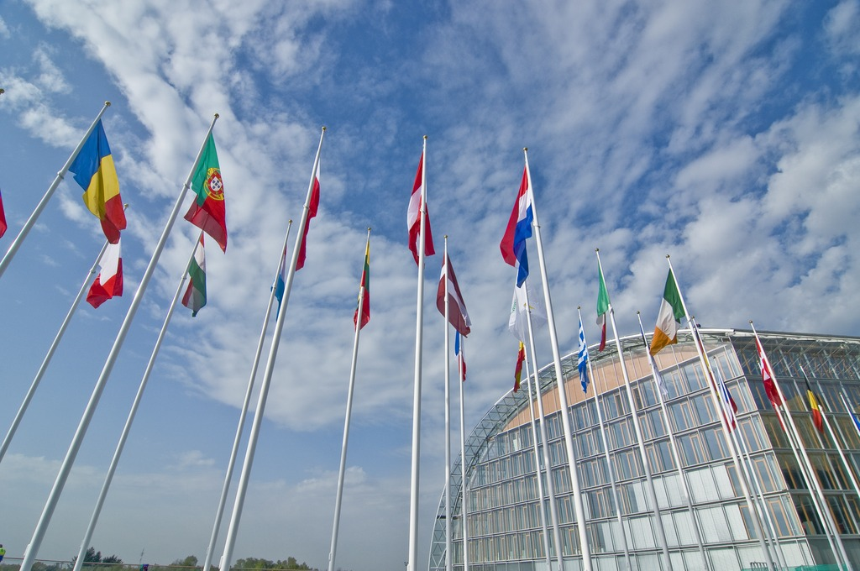
Thank you!
For further questions: vilnius@eib.org

