Slide 1
EIB Product Offering
Financial Institutions Department
Virginia Gecaite
Luxembourg, April 2022

Slide 2
Disclaimer
This Presentation is incomplete without reference to, and should be viewed solely in conjunction with, the oral briefing provided by the European Investment Bank (“EIB”). The terms and conditions are intended as an outline for discussion purposes only and made on an indicative basis. All figures set forth in this Presentation are subject to change, to a satisfactory due diligence and to all necessary internal approvals of EIB (in particular of its credit committees).
The information in this Presentation reflects the prevailing conditions and the view of EIB as of this date and are accordingly subject to change and based on carefully selected sources believed to be reliable. EIB has not independently verified this information and does not make any representation or will be liable that such information is accurate, valid, timely and complete.
This Presentation is provided without any liability whatsoever by EIB and shall not constitute any obligation of EIB to extend credit facilities to the Company or to carry out a due diligence review of the aspects relevant for the financing of the Project.
Neither this presentation nor any of its contents may be duplicated, published or used for any other purposes without the prior written consent of EIB.
European Investment Bank

Slide 3
Product offering
1. Multi Beneficiary Intermediated Loan (MBIL)
2.a Risk Sharing - Guarantee on existing exposures
3. Asset Backed Securities (ABS)
2.b Risk Sharing - Guarantee on new exposures

Slide 4
1. Multi Beneficiary Intermediated Loan (MBIL)

Slide 5
Key features & terms
Long-term liquidity instrument provided by EIB to Financial Intermediaries at attractive terms, with a view of supporting eligible Final Beneficiaries (as per the General eligibility criteria presented in General eligibility criteria slides)
Key loan terms:
Senior preferred loan
Long tenors (depending on the loan structure and underlying projects) of up to 12 years, with a possibility of introducing a grace period of up to 4 years
Final pricing depends on the loan structure and credit standing of the Borrower
Large lending volumes, which can be drawn in multiple tranches
Allocation period of 18-24 months
Drawdown period of up to 12 months without a commitment fee
Funding in various currencies
Transactions are undertaken on the basis of limits linked to Counterparts’ equity, that are established for both secured (e.g. financial collateral or parent guarantee) and unsecured lending
EIB will include such clauses as: Negative Pledge, Change of Control, Material Adverse Change, Pari Passu, or Loss of Rating

Slide 6
Main requirements
Transparency: Final Beneficiaries are informed of EIB involvement (form of communication to be agreed with EIB)
Transfer of Financial Advantage: part of the estimated Financial Advantage needs to be transferred from the Financial Intermediary to the Final Beneficiaries, in form of interest rate reduction and longer loan tenor
Complementarity: EIB leverage effect as Financial Intermediary commit to provide Final Beneficiaries loans of at least 2x the EIB loan amount
Allocation reporting on sub-loans: standardized and simplified format

Slide 7
2.a Risk Sharing –Guarantee on existing exposures

Slide 8
Main features & requirements
EIB provides an unconditional, irrevocable, first-demand, un-funded guarantee to a Financial Intermediary on existing exposures
Existing (or) guaranteed Portfolio
The guarantee can cover up to 50% of losses in respect of defaults, on pre-identified large exposures (typically 1-3 exposures)
Existing exposures must involve EU borrowers and finance operations that are not in EIB excluded sectors. Ideally, these borrowers should be also EIB direct counterparts
EIB will appraise the credit quality of each single underlying exposure separately
NEW Portfolio/Allocations
In exchange to the guarantee, the Financial Intermediary commits to generate, within a certain allocation period a new portfolio of eligible loans, for an amount double the EIB guarantee

Slide 9
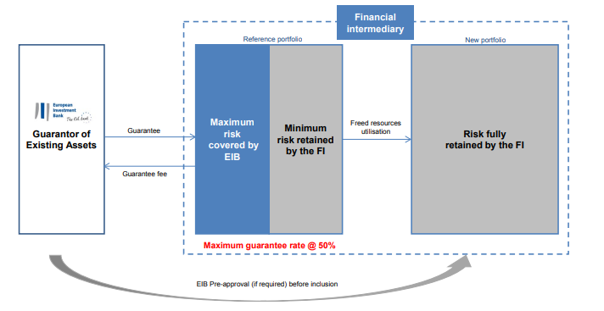
Key product terms
The tenor of the guarantee or risk participation is linked to the maturity profile of the underlying exposures
Final pricing depends on loan structure and credit quality of the exposures in the reference pool
Allocation period of 18-24 months
Product benefits:
facilitating new lending to SMEs and Mid-Caps by reducing the risk-weighted assets of the counterpart, while also helping to alleviate internal portfolio concentrations and limit restrictions. Given the unconditional nature of the EIB guarantee, it essentially provides capital relief to the financial intermediary. This would result in increased lending capacity for the Financial Intermediary and easier access to finance for the European SMEs and Mid-Caps

Slide 10
2.b Risk Sharing –Guarantee on new exposures

Slide 11
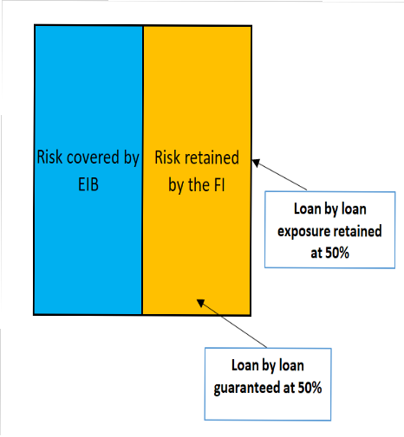
Main features & requirements
EIB provides unfunded, uncapped guarantees (and counter-guarantees) to a Financial Intermediary on a NEWLY originated portfolio
Guarantee structure: Credit risk coverage will be provided for a portfolio of new exposures, on a loan-by-loan basis;
Risk coverage: Typically up to 50% on a loan by loan & pari-passu basis, covering outstanding principal and accrued interest (up to 90 days) in respect of defaulted loans;
Risk retention: 50%. Additional coverage from a third-party is possible as long as the FI retains at own risk, 50% of the credit risk on each exposure.

Slide 12
Main features & requirements
Eligible counterparts: duly authorized credit institutions – Banks, Leasing & Factoring Entities, NPBIs (jointly referred to as “FIs”)
Benefits of the LRS product
To the FIs:
• Provides significant, uncapped, risk protection
• Designed with the view of providing capital relief
• Alleviates internal concentrations and limit restrictions on individual obligors and/or sectors
• Implemented under a full delegation approach
To the Final Beneficiaries:
• Facilitates access to finance and at beneficial terms, in the form of reduced interest rates and/or longer maturities.
Pricing: pricing grid based on a mapping exercise performed during the Due Diligence process, based on FI’s 1-year PD and the tenor of the guaranteed exposure

Slide 13
Key product terms
Guaranteed exposures:
SMEs: Working capital and investment projects, with a minimum loan size of EUR 1 m and a maximum project cost of EUR 25 m;
Mid-caps: Working capital and investment projects, with a maximum project cost of EUR 50 m;
Large corporates: Working capital, limited only to Supply Chain operations, with a maximum project cost of EUR 200 m;
PSEs: Working capital and investment projects, with a maximum project cost of EUR 25 m.
Supply chain operations and financial leases are eligible.
Notes: (i) the project cost for working capital loans is equal to the total amount of the exposure, (ii) the guaranteed exposure is equal to the size of the exposure multiplied by the guarantee rate (typically 50%);
Standard MBIL eligibility criteria for EIB financing will apply and details can be provided on demand.
Tenor of the Guarantee: Up to 12 years
Portfolio risk mitigants: Such as max. loan amounts for granularity, eligible rating classes, concentration limits by rating class, sector and obligor to be assessed on a case by case.

Slide 14
Key product terms
Inclusion period: 24-36 months. Exposures originated 6 months before the start of the inclusion period are also eligible;
Replenishment: No replenishment;
Additional portfolio: No Additional Portfolio requirement;
Policy focus of the guaranteed portfolio: Similar to other EIB transactions, the guaranteed portfolio will need to have a partial focus in one of EIB’s priority lending areas – i.e. Climate Action or Innovation;
Currency: Predominantly EUR, but other tradable EIB currencies are possible, matching the currency of the underlying exposures;
Transfer of the Financial Advantage to the final beneficiaries: the FI will be required to replace for each exposure the risk margin charged in line with its pricing policy with the guarantee fee. Alternative mechanism for Supply Chain operations can be discussed.

Slide 15
3. Asset Backed Securities (ABS)

Slide 16
EIB securitization offering
REGULATORY CAPITAL RELIEF
FUNDING
By providing unconditional, irrevocable synthetic guarantees on tranched portfolios, allowing the beneficiary to release regulatory capital
As an outright cash investor
Cooperation with EIF as very often Senior tranche investment is split between EIF and EIB. In those instances EIF provides an unconditional, irrevocable guarantee on a part of the ABS tranche purchased by third-party investors.
Synergy with EIF which provides the guarantee on the tranches via guarantee agreement and at the same time transfers the risk on the guaranteed tranches to EIB via back-to-back agreement. The later is not visible to the seeker of capital relief
Portfolios denominated in EUR or any other tradable EIB currency. The entire portfolio must be denominated in same currency.
Final, common purpose of catalyzing lending to SMEs and Small Mid-Caps

Slide 17
Cash transactions
EIB Group is a cornerstone investor in several ABS funding and capital relief transactions across Europe, taking senior and/or mezzanine risks
In case of EIB participation in the senior tranche an external rating (complemented by an internal rating as well) is necessary
Many repeat transactions, as we like to keep strong relationships with our partners
EIB typically invests in mezzanine (BB- rating) and/or senior (A/AAA rating) tranches with a WAL of c. 3 years
17

Slide 18
Synthetic securitizations
Lending
Final Beneficiaries
Financial Intermediary
Receivables
Retrocession Payments
Capital Relief on the underlying portfolio of Assets
Pool of Assets
Senior Tranches
Mezzanine Tranches
Junior Tranches
EIB Invests in Senior and/or Mezzanine Tranches
EIB Group cooperation regarding due diligence and structuring
EIF Invests or Guarantees Senior and/or Mezzanine Tranches
No need for a transaction arranger / external rating agency

Slide 19
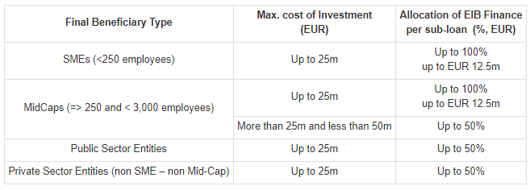
General eligibility criteria (1)
There are four categories of eligible Final Beneficiaries: SMEs with fewer than 250 employees, Mid-Caps with up to 3,000 employees (by the EC definition), Public Sector Entities (PSEs) and Private Individuals undertaking green projects
Final Beneficiaries in all economic sectors are eligible, with the exception of “EIB Excluded Sectors” as listed in the Side Letter to the EIB Finance Contract
Final Beneficiaries must be located in EU Member States
The sub-projects can represent investments by the Final Beneficiaries in tangible or intangible assets, as well as and medium-to-long term working capital needs
The share of the EIB funding vs. the total cost of project is the following:

Slide 20
General eligibility criteria (2)
EIB operations should have a minimum dedication to one of EIB’s main public policy goals, i.e. climate action and sustainable environment (CA&ES), or innovation and digitalization
CA&ES
Most common Climate Action and Environmentally Sustainable projects include electric vehicles, solar/wind power plants, energy efficiency housing, electricity transmission and distribution infrastructure
EIB Green Checker Tool (https://greenchecker.eib.org/) made available to Counterparts to allow them to verify the eligibility of certain investments
INNOVATION & DIGITALIZATION (selected examples)
The Final Beneficiary intends to use the sub-financing to invest in producing or developing products, processes and/or services that are innovative and where the business plan evidences a risk of technological or industrial failure, or a business risk
The Final Beneficiary undertakes to spend an amount at least equal to 80% of the sub-financing in R&I expenses/investment in the next three years following the signature of the sub-financing document as indicated in its business plan
The Final Beneficiary has been awarded an innovation prize during the last two years preceding the submission of the allocation proposal
The Final Beneficiary has registered at least one Intellectual Property Right (such as a patent) in the last two years preceding the submission of the allocation proposal

Slide 21
More information at:
www.eib.org
info@eib.org

