Slide 1
The InvestEU Advisory Hub
8 April 2022, InvestEU Roadshow, Tallinn

Slide 2
EIB as the main advisory partner under InvestEU
Objectives
Provide support throughout the entire project life cycle
Reinforce the capacities and knowledge of clients and intermediaries
Contribute to achieving the goals of the Green and Digital transition
Help public resources to go further through financial instruments and the combination of different funding sources, while mobilising complementary private sector investment
Contribute to building a pipeline of robust and sustainable projects across all InvestEU policy windows

Slide 3
InvestEU Advisory Hub and related EIB advisory initiatives
SUSTAINABLE INFRASTRUCTURE
SOCIAL INVESTMENT AND SKILLS
incl. ELENA
Building a sustainable Europe
Innovating the way we deliver social services
Improving social infrastructure and services
Bringing education and skills to the next level
Reinforcing the microfinance and social enterprise finance sectors
CROSS-SECTORAL WINDOW
RESEARCH, INNOVATION AND DIGITALISATION
SMALL AND MEDIUM-SIZED COMPANIES
JASPERS
Fostering research, innovation and digitalisation
Paving the way to circular cities
Advancing the gender agenda
Working towards a just transition

Slide 4
InvestEU Advisory Hub: services and initiatives
Project advisory
Project identification/generation
Project preparation & development
Planning & implementation of investment projects
Financial structuring
Establishment of investment platforms & blending facilities
Capacity building
Strengthening capacity & investment readiness of organizations
Environmental and/or social sustainability structuring and impact assessments
Procurement and compatibility with State aid rules
Market development
Market development activities
Communication & awareness raising
SUSTAINABLE INFRASTRUCTURE
RESEARCH, INNOVATION AND DIGITALISATION
InvestEU Advisory Hub
SOCIAL INVESTMENT AND SKILLS
SMALL AND MEDIUM-SIZED COMPANIES
CROSS-SECTORAL WINDOW

Slide 5
Examples of supported projects

Slide 6
Example in digitization & innovation
SiPearl designs and develops high-performance low-power European microprocessors for HPC and a range of emerging applications, such as AI and connected mobility.
SiPearl’s mission is to develop the next generation of high-end energy-efficient microprocessors that will form the core of European supercomputers.
Advisory Hub assisted the promoter in developing the investor material for fundraising by preparing a well-structured and comprehensive business plan in line with market standards. The EIB loan was signed in Q1 2022, a venture debt financial support of EUR 20 million.

Slide 7
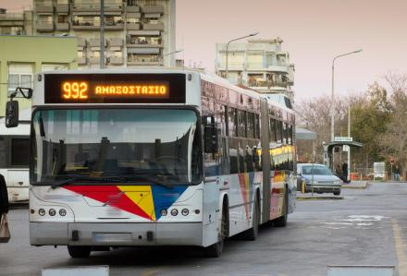
Example in sustainable transport
The Greek Ministry of Transport is working closely with the urban transport authorities of the two cities to improve bus services, involving the purchase of around 1 500 green buses. JASPERS supported the ministry in developing a 10-year fleet replacement plan and defined a scheme for the first investment phase in 2023-2024, with a view to making future applications for European Union grants. To complement JASPERS’ support on structural funds, the Advisory Hub accelerated the implementation of the project by evaluating bus technologies and their effectiveness, fleet sizes to accommodate efficient levels of bus route services, maintenance strategies.

Slide 8
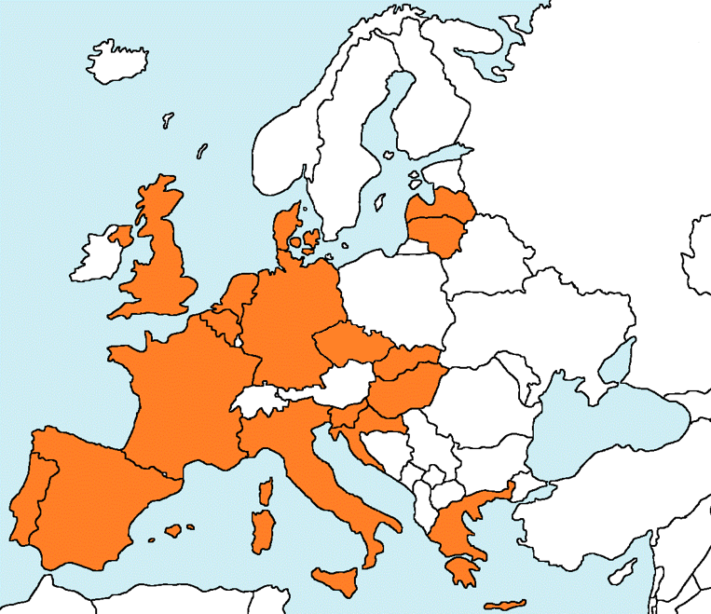
Example in energy efficiency
ELENA EPC related Projects:
54 projects include ESCOs/EPCs;
31 projects completed;
23 ongoing projects;
Expected Investment: EUR 3.9 billion;
Expected ELENA grant: EUR 91.8 million;
18 countries.
ELENA Portfolio:
Total of 132 projects supported:
58 projects completed;
74 ongoing projects;
Expected Investment: EUR 10.5 billion;
Expected ELENA grant: EUR 256 million;
24 countries (no projects in Malta, Cyprus, Estonia and Bulgaria).

Slide 9
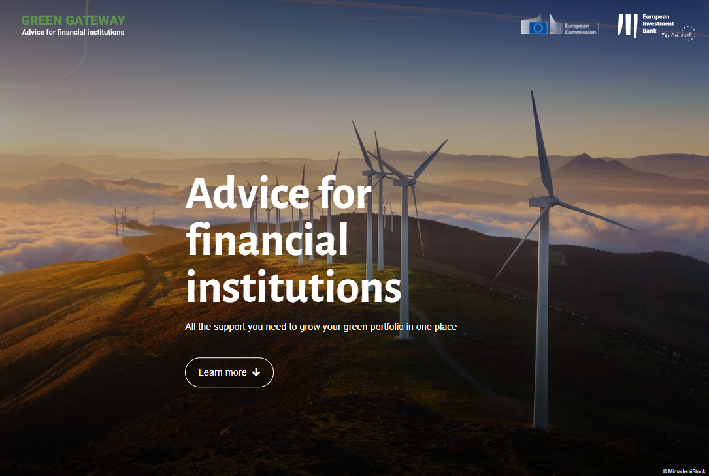
Example of advisory support for financial intermediaries
Green Gateway web portal
Green Eligibility Checker https://greenchecker.eib.org/ to assess EIB green projects
EIF Sustainability Guarantee Tool
to assess EIF InvestEU sustainable projects
Green Gateway E-Library EIB green guidance and knowledge materials
Green Gateway e-Learning online training on EIB green financing & Taxonomy
https://greengateway.eib.org/

Slide 10
Thank you for your attention
www.europa.eu/investeu
eiah.eib.org

