Slide 1
Tallinn, 8 April 2022
Michael FEITH
Policy Officer InvestEU
DG Economic and Financial Affairs (ECFIN)

Slide 2
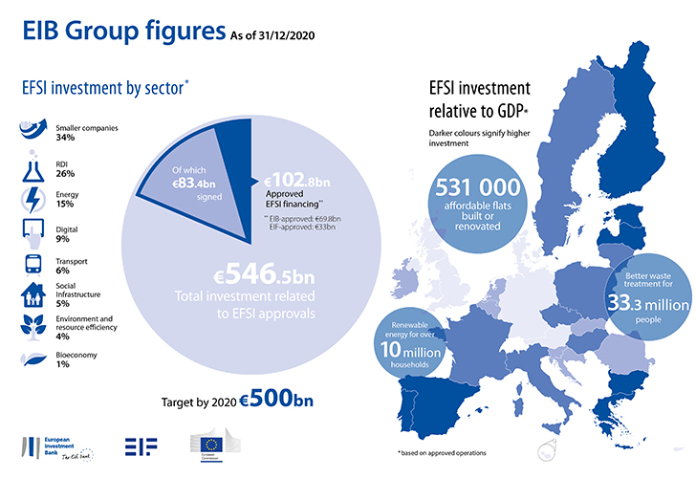
Investment Plan for Europe / EFSI (2015-2020)
The European Fund for Strategic Investments (EFSI) mobilized - with the help of a EUR 33.5 bn guarantee - investments of almost EUR 550 bn over 5 years:
733 infrastructure projects supported across the EU
816 deals or investments in funds for the profit of SMEs
About 1 460 700 SMEs benefitted from access to financing – support that strengthened the EU economy and created jobs
Economic estimates suggest that by 2022, investments realized with the support of EFSI increased EU’s GDP by 1.9% and added 1.8 million jobs compared to the baseline scenario.
Notes:
InvestEU builds on the positive experience of Investment Plan for Europe with its European Fund for Strategic Investments (EFSI) implemented by the European Commission and the European Investment Bank Group.
With the help of EU budget guarantee of 33.5 bn EUR within five years EFSI mobilized investments of almost 550 bn EUR.
Around 740 infrastructure projects benefitted from EU funded investment support and more than 800 deals/investments were made in funds supporting SMEs access to finance. Around 1.5 million SMEs benefitted from financing.
Investment Plan for Europe helped financing more than 500,000 affordable flats in the EU, renewable energy for over 10 million households as well as better waste treatment for more than 33 million people.
Macroeconomic impact of Investment Plan for Europe: economic estimates suggest that by 2022, investments realized with the Investment plan/EFSI increased EU’s GDP by 1.9% and added 1.8 million jobs compared to the baseline scenario.

Slide 3
Investment Plan for Europe / EFSI in Estonia (2015-2020)
December 2020
Total financing under the European Fund for Strategic Investments (EFSI) in Estonia amounts to EUR 264 million and is set to trigger EUR 2.4 billion in additional investments
Infrastructure and innovation projects
9 approved projects financed by the European Investment Bank (EIB) with EFSI backing approximately EUR 201 million in total financing set to trigger EUR 1.2 billion in total investment (including upgrade of Tallinn airport, R&D and energy storage or food production projects)
Small and medium enterprises (SMEs)
10 approved agreements with intermediary banks financed by European Investment Fund (EIF) with EFSI backing
EUR 63 million in total financing set to trigger approximately EUR 1.2 billion in investments with some SMEs and mid-cap companies expected to benefit from improved access to finance
Notes:
Estonia

Slide 4
The InvestEU Programme 2021 - 2027
Notes:
InvestEU contributes to a sustainable growth of the EU economy, driven by private and public sector investments supporting EU policy priorities: Green Deal, Digital transition, Innovation and Social investments and skills.
The programme consists of three components: the InvestEU Fund, the InvestEU AdvisoryHub, and the InvestEU Portal.
The InvestEU Fund will be implemented through financial partners who will invest in projects using the EU budget guarantee of €26.2 billion.
75% of this EU budget guarantee is attributed to the financial products offered by the EIB Group, our main implementing partner. Remaining 25% of the EU budget guarantee is accessible to other international financial institutions active in the EU and national promotional banks.
The EU budget guarantee will back the investment projects of the implementing partners, increasing their risk-bearing capacity and helping to crowd-in at least €372 billion in additional investment.
InvestEU Fund will provide loans, equity or guarantees.
To support the mobilization of investments and help with building a steady pipeline of qualitative investment projects, the InvestEU Advisory Hub will provide technical assistance and advisory support to project promoters and financial intermediaries. The InvestEU Advisory Hub also provides advisory support to any project developer seeking to finance investments and growth, not only those seeking support from the InvestEU Fund.
The InvestEU Portal as the third pillar of the InvestEU Programme. It is the EU financed meeting space providing visibility and networking and matchmaking opportunities for EU project developers and global investors.
InvestEU programme is part of the NextGenerationEU, a €800 billion temporary recovery instrument, and the new EU multiannual financial framework for 2021-2027.
NextGenerationEU and the multiannual EU budget have been design with the overarching objective of repairing the immediate economic and social damage caused by the coronavirus pandemic. The investment focus in the EU will be towards greener, more digital, more resilient and better fit economy for the current and forthcoming challenges.

Slide 5
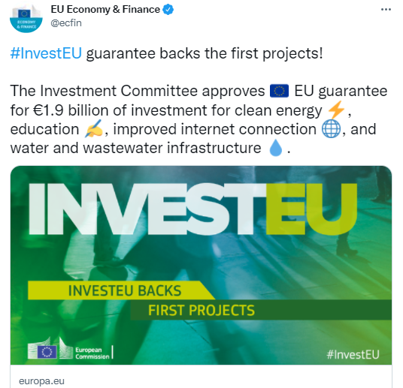
InvestEU Fund
Single fund bringing together previous different EU-level financial instruments
EUR 26 bn EU budgetary guarantee
No grants only loans, equity or guarantees
Mobilise EUR >372 bn in additional investment across Europe, by attracting public and private investments
Implemented by financial partners across the EU, with the EIB Group as major partner.
Independent Investment Committee approves projects receiving budgetary guarantee
Notes:
The InvestEU Fund will be implemented through financial partners who will invest in projects using the EU budget guarantee of €26.2 billion, whereof 75% are attributed to the EIB Group. The entire budget guarantee will back the investment projects of the implementing partners, increase their risk-bearing capacity and thus mobilise at least €372 billion in additional investment.
Further to the EIB Group who is the main partner, international financial institutions active in Europe and national promotional banks will be able to use a share of the guarantee (25% in total) to support investment and projects schemes.
The InvestEU Fund General Scheme:
The EU guarantee has to:
Address market failures or sub-optimal investment situations
Provide support only to final recipients that are deemed economically viable according to internationally accepted standards
Achieve additionality by preventing the replacement of potential support and investment from other sources
Not distort competition in the internal market and be consistent with State aid rules
Achieve a leverage and a multiplier effect, by mobilising a global investment exceeding the size of the guarantee including the maximisation of private investment

Slide 6
InvestEU four policy windows
Link to Recovery and Resilience Facility: Funds from RRF may be contributed by Member States for provisioning the InvestEU guarantee.
Notes:
Our main objective under the InvestEU programme is to attract private capital and mobilise more than 372 billion euros to support public and private investment in key EU policy priorities structured under four policy windows:
• Sustainable infrastructure
• Research, innovation and digitalisation
• Small and medium-sized companies
• Social investment and skills
There is also a link to the Recovery and Resilience Facility: funds from the RRF may be contributed by the Member States for provisioning the InvestEU guarantee.
Boosting investments into climate: Under the “sustainable infrastructure” window, 60% of the investments will contribute the EU climate objectives. For the entire InvestEU, at least one third (30%) of the investments will go towards climate change mitigation and adaptation.
Commission guidances on sustainability proofing and climate & environment tracking will help potential project developers and financial partners to identify, assess and mitigate climate, environmental and social risks.
The EU Taxonomy on sustainable activities will be used.
All investments over 10M EUR will need to go through the sustainability proofing.

Slide 7
Member States Compartment
The InvestEU Regulation foresees contributions to the MS-C of InvestEU from shared management funds (ESIF) and the Resilience and Recovery Facility.
Five Member States have expressed interest in contributing to the Member State Compartment of InvestEU:
RRF: Greece, Romania and Bulgaria
ESIF: Bulgaria, Czech Republic and Finland
The Member State compartment is a delivery mechanism having synergies with structural funds and with RRF since it is used to deliver objectives under those policy frameworks
The EU guarantee is financially a higher quality of guarantee than most Member States are able to provide

Slide 8
InvestEU Advisory Hub
Advisory support to skills, education, social housing, hospitals, social innovation, healthcare, microfinance, social enterprises and more
Advisory support to research and innovation, digitalization, scaling up innovative companies, facilitating access to finance for small and medium-sized companies (SMEs), small mid-cap companies
CROSS-SECTORAL ADVISORY SUPPORT
Advisory support to clean energy and mobility, digital connectivity, circular economy, climate adaptation, bio-economy, environment and natural capital
Advisory support to cross-sectoral priorities, sustainability action, just transition and more
EIB and other advisory partners
Project advisory
Market development
Capacity building
Assistance during the entire project life-cycle for promoters and financial intermediaries
to implement financing and investment operations
Notes:
The Advisory Hub has been launched following the signature of the first Agreement with the EIB and is now operational, which Ando will present more in detail in a moment.
The Hub’s role is to connect public and private sector promoters and financial intermediaries with Advisory Partners, who then work directly together to help projects reach the financing stage.
The Advisory support is also focusing on the EU priorities such as Climate action, Digitalisation, Just Transition (territories) or Strategic Investments, and like the rest of the InvestEU Programme is calibrated around the four policy windows.
The Advisory Partners will assist project promoters during the entire project life-cycle:
from identification and preparation, through development or financial structuring, to procuring and implementation of investment projects.

Slide 9
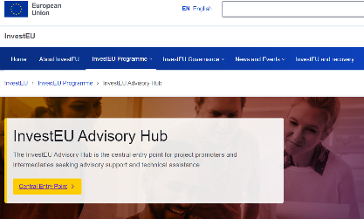
InvestEU Advisory Hub
Simplified access through InvestEU Advisory Hub Central Entry Point
Smooth transition from existing to new advisory initiatives
https://webgate.ec.europa.eu/InvestEU_AH/wizard
Notes:
The European Investment Bank Group (EIBG) remains our main advisory partner and will implement 75% of the InvestEU Advisory Hub budget.
This allows for the continuation of very well-known on the market and successful advisory initiatives, such as the ELENA, which focuses on energy efficiency in buildings and urban transport, or the support to SMEs and social investments.
The InvestEU Hub will enable a smooth rollover of current advisory initiatives and tools (e.g ELENA, EIAH, incl. GreenGateway, InnovFin Advisory). It will also upgrade and improve them to respond to the new policy priorities such as the digital and green transition, just transition advisory support to public sector projects in the Just Transition regions and circular economy projects in European cities.
We work either through our Partner(s) or the InvestEU Advisory Hub Central Entry Point. This single gateway hosted by European Commission will simplify and facilitate access to the EU funded advisory support. The private and public project promoters interested in EU advisory support are invited to get in touch through these two channels.

Slide 10
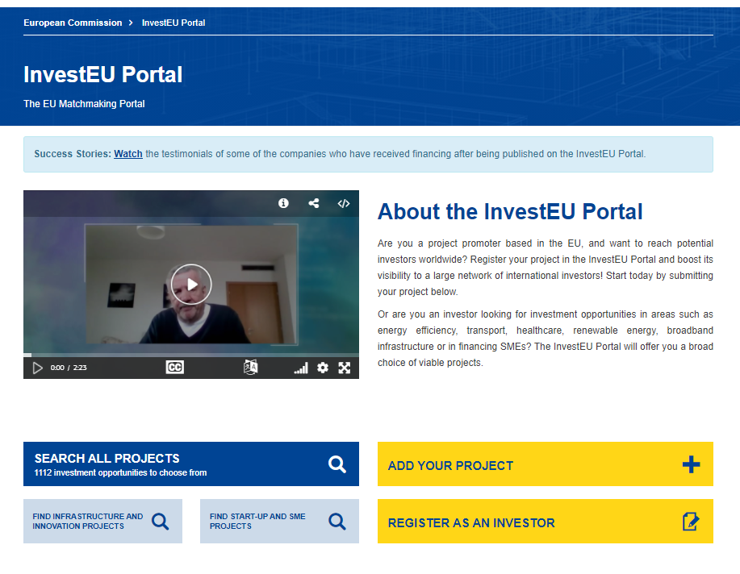
InvestEU Portal: bringing together promoters with investors
EU Promoters
International Investors
Notes:
The InvestEU Portal is offering a database of investible projects in the EU. It is free of charge and the submission of projects happens online.
More than 1300 projects are published in various sectors, in particular in the Green and Digital sectors.
Projects that are tackling the Covid-19 crisis are highlighted on the Portal with a dedicated tag.
To be eligible for publication, a project shall:
have a minimum size of EUR500000;
be active in one of the pre-determined high economic value-added sectors;
be situated and be promoted by a public or private legal entity established in an EU Member State;
have started or be expected to start within three years of the date of submission;
be clearly described as an investment project;
be compatible with all applicable EU and national laws.

Slide 11
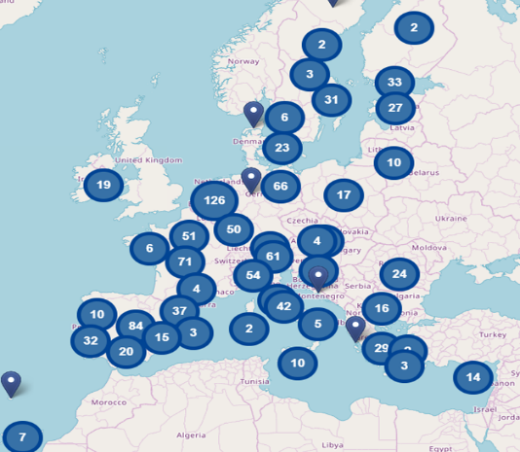
State of play
as of end-March 2022
KNOWLEDGE & DIGITAL ECONOMY
718 projects
ENERGY UNION
142 projects
TRANSPORT
194 projects
SOCIAL INFRASTRUCTURE & OTHER
484 projects
RESOURCE &ENVIRONMENT
221 projects
1369 projects published as of March
~2337 projects submitted
~1366 project dots on the map
Promoters can choose up to three countries for each project.
FINANCING FOR SMES & MID-CAPS
646 projects
Notes:
Our pitching events and project promotions on the InvestEU Portal work.
InvestEU Portal insures continuity and improvement from the European Investment Project Portal (EIPP), where more than 90 projects advertised have already received financing after their publication on the Portal.

Slide 12
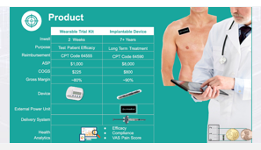
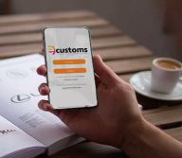
InvestEU Portal success stories
Capri (Ireland)
BioElectronics device which stimulates the peripheral nervous system in order to address many of the world’s most pressing healthcare needs.
Health & Digital
eCustoms (Spain)
A platform that simplifies and accelerates logistic processes in a company using Blockchain technologies.
SMEs & Digital
Notes:
- Last but not the least, let me share an outstanding success stories that has received financing after being published on the Portal:
Capri (from Capri-Medical) from Ireland is a successful project that attracted its investors for financing a smart and digital BioElectronics device that stimulates the peripheral nervous system and helps to address certain health conditions. The project secured 70% of financing after being published on the Portal.
eCustoms (from Blockchain Customs Technology) is a successful Spanish project simplifying, digitalising and accelerating the logistic and customs processes within companies through the use of Blockchain technologies.

